Slide 1
Efficient project management by Employee Over-Time prediction

Slide 2
Agenda
Challenge
Expected Solution
Data Analysis
Models Built
Details about Solution
Next Steps

Slide 3

Challenge
A manufacturing unit is consistently facing project over-time to finish.

Slide 4

Expected Solution
Build a Machine Learning model which will predict whether an employee will bill overtime on a project or not.

Slide 5
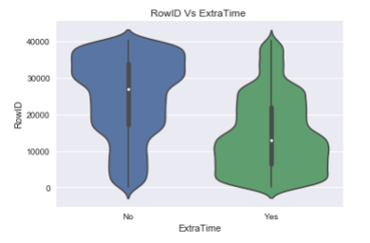
Data Analysis
Luckily no missing values
Interesting point is RowID also feature for classifier
Features added
Total Years Exp
Within Comp Exp
Imbalanced Data

Slide 6
Models Built
Model Accuracy
Logistic 65%
Random Forest 75%
SVM 80%
Adaboost 68%
Bagged Decision Trees 75%
Stochastic Gradient 72%
Boosting

Slide 7
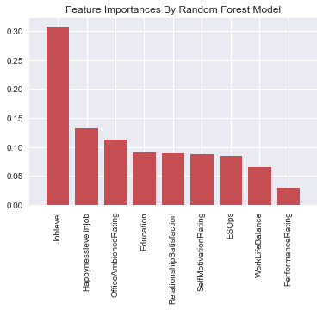
Details about Solution

Slide 8
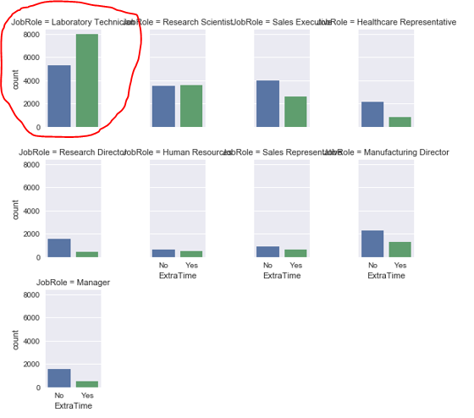
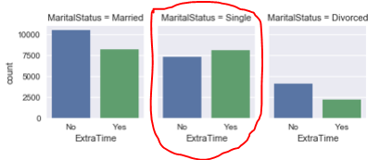
Details about Solution
Job Role
Marital Status

Slide 9
Next Steps
Need to tune Hyper parameters to increase accuracy.

Slide 10
Questions?

Slide 11
Thank you

